Slide 1
SOMERSET PURPOSE
Somerset Academy, Inc. promotes a transformational culture that maximizes student achievement and the development of accountable, global learners in a safe and enriching environment that fosters high-quality education.
S - Set high expectations
O - Objective
M - Meaningful curriculum
E - Effective
R - Resourceful and responsible life long learners
S - Scholars who achieve proficiency and beyond
E - Evaluate continuously and use data to drive curriculum
T - Teachers who are highly qualified

Slide 2
LINCOLN MEMORIAL UNIVERSITY
http://www.lmunet.edu/
Application Fee waived for SCPA students
In state tuition offered
Harrogate, TN
Bachelor of Science
Athletic Training
Veterinary Health Science
Criminology and Criminal Justice
Social Work
Environmental Science
Bachelor of Arts
Art
Media Communications
Business
Political Science
Associates of Science in Nursing
Bachelor of Science in Nursing
Bachelor of Business Administration
Accounting
Marketing

Slide 3
DO NOT. . .
“Hang out” in the stairwells or on the second floor during lunch.
Chew gum. DO NOT BRING GUM!
Go on the basketball court with a skateboard!
Use the elevator without approval from the office.
Leave campus if you are a Middle Schooler, Freshman or Sophomore (Except for DE students)
Allow an underclassmen in your vehicle without prior permission, or you will lose all privileges for the remainder of the school year.
Throw anything off the balcony.
Throw anything from the ground level to the 2nd floor.
Eat or carry food over the basketball court or turf field
Litter or leave garbage around at lunch
Hang out by the wavy wall side or behind the basketball court bleachers
Hang on or grab the basketball nets/rims
Playing “keep away” = a detention
Yoga pants/ leggings/ are not allowed. Not even during dress down days. Dress code violations earn detentions
You are not to go to the Deans’ office during class to argue a detention. You will be turned away.

Slide 4
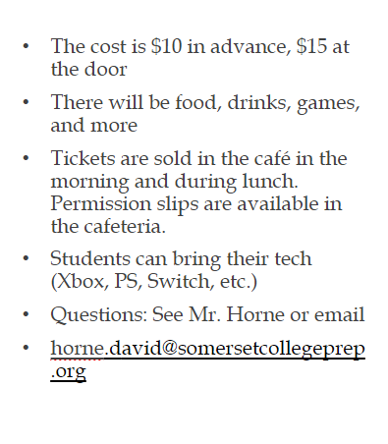
Middle School
Tickets on sale starting Wednesday November 2nd

Slide 5
NO FOOD ON THE COURT

Slide 6
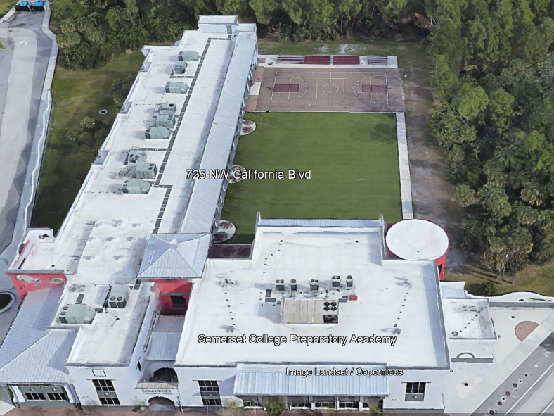
There is NO open food or liquid on the turf!!!
If you are caught, you will be having a meeting with the deans
TURF!

Slide 7
Tutoring Schedule
Mondays – ENGLISH (please see the schedule for which teach is staying for tutoring. The schedule is posted in all English teacher Classrooms)
Tuesdays – Math (ALL Math teachers)
Wednesdays – Social Studies
Thursdays – Science
Fridays – NONE
Need tutoring for electives? See your teacher to schedule.

Slide 9
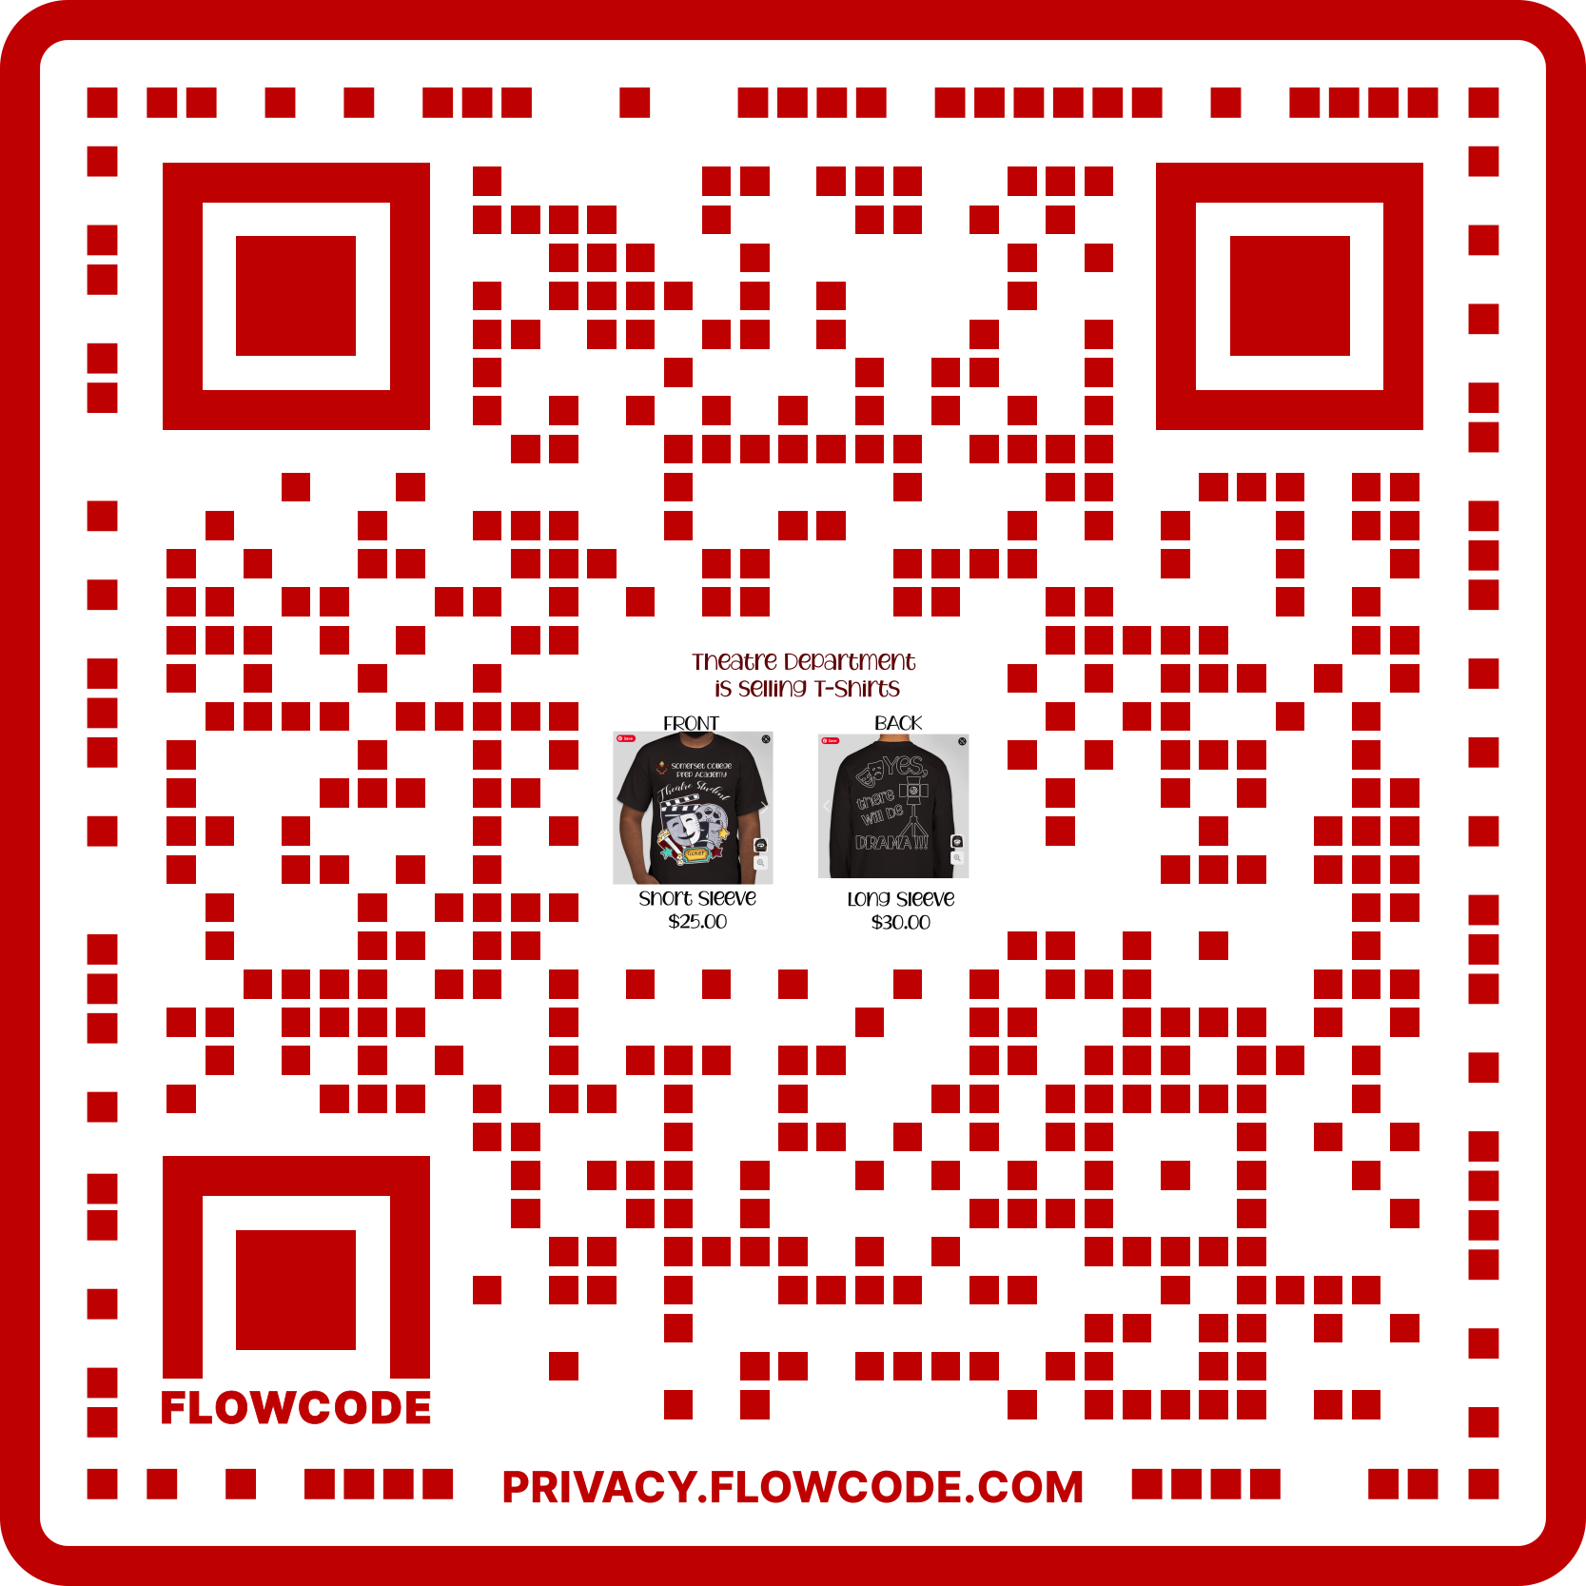
T-shirts are available for purchase from Oct 13-Nov 7th.
Delivery will be sometime after Nov 25.
Help support SCPA Theatre Department as we raise funds to build up our Theatre Budget to offset costs for our future productions and the purchase of much needed additional theatre equipment.

Slide 10
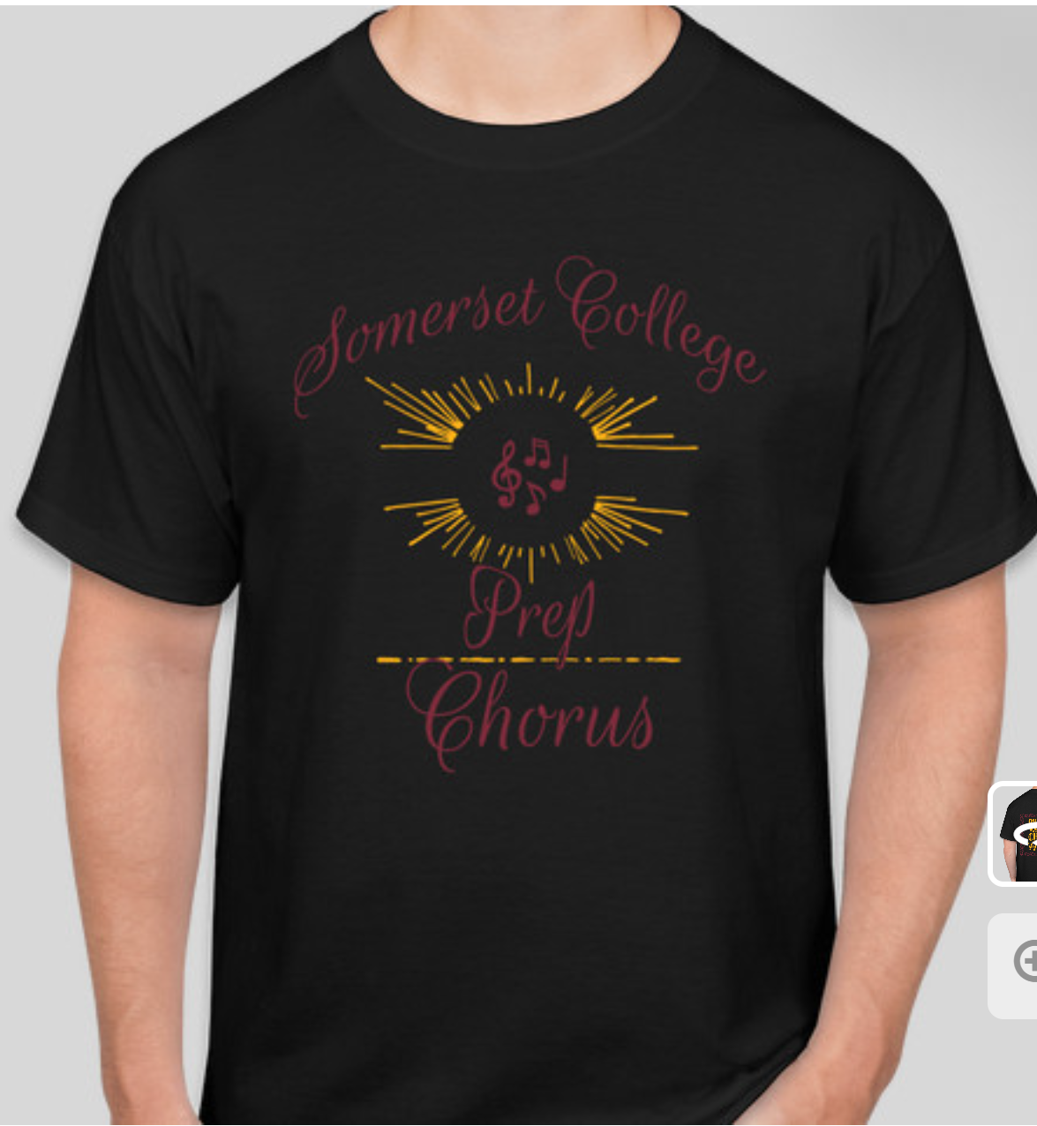
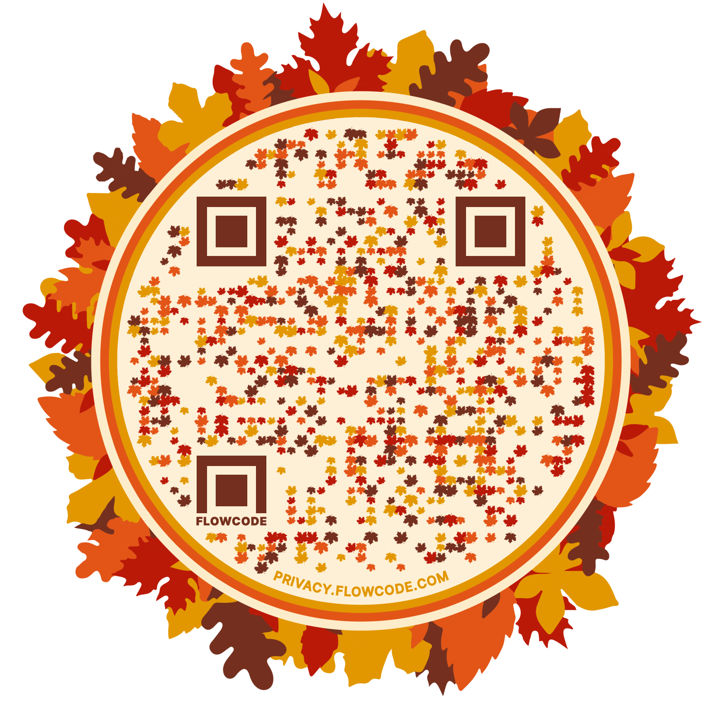
Chorus T-shirts and hoodies for sale!
Can be worn on Monday (chorus club day) and Friday!
T-shirt $25
Hoodie $40
Scan QR Code below – purchase by November 11th

Slide 11
Fall Lock-In
The cost is $10 in advance, $15 at the door
There will be food, drinks, games, and more
Tickets are sold in the café during lunch. Permission slips are available in the cafeteria.
Students can bring their tech (Xbox, PS, Switch, etc.)
Further Info: estab002@somerset.colegia.org
Nov 4-5 9pm-6am

Slide 12
Supporting the VEA Foundation:
Canned Food Drive
When: October 31- November 9th Location: Cafeteria ^{- No OPENED cans} ^{- No containers made of glass}
- Only food for Human Consumption
*House event: Items must be placed in boxes that are separate by each house. Each item will be counted and the house with the most cans will win!
1st place - 100 points, 2nd place - 50 points, and 3rd place - 25 points.

Slide 13
House Olympic Games
Houses | Points Earned | Totals
 | Soccer | Strength | Football | Volleyball | Basketball | Turf & Field
Athena | 75 |  | 50 |  |  |  | 125
Ares | 0 |  | 50 |  |  |  | 50
Hestia | 0 |  | 100 |  |  |  | 100
Poseidon | 75 |  | 25 |  |  |  | 100
Zeus | 75 |  | 0 |  |  |  | 75

Slide 14
ALL POINTS FROM AUGUST TO OCTOBER | ARES | ATHENA | HESTIA | POSEIDON | ZEUS
May 2022 EOC Scores- | 277 | 356 | 382 | 319 | 284
Pink-Out Day- | 57 | 69 | 67 | 71 | 62
Hygiene Drive- | 60 | 0 | 0 | 100 | 30
Olympic Soccer- | 0 | 75 | 0 | 75 | 75
Olympic Football- | 50 | 50 | 100 | 75 | 0
Q1 Perfect Attendance- | 190 | 210 | 250 | 310 | 270
Q1 GPAs- | 531 | 507 | 536 | 555 | 493
Detentions- | -228 | -276 | -242 | -206 | -220
Saturday Detentions- | -155 | -70 | -170 | -155 | -170
Q1 Tardies- | -25 | -23 | -20 | -14 | -17
TOTAL | 757 | 898 | 903 | 1130 | 807

Slide 15
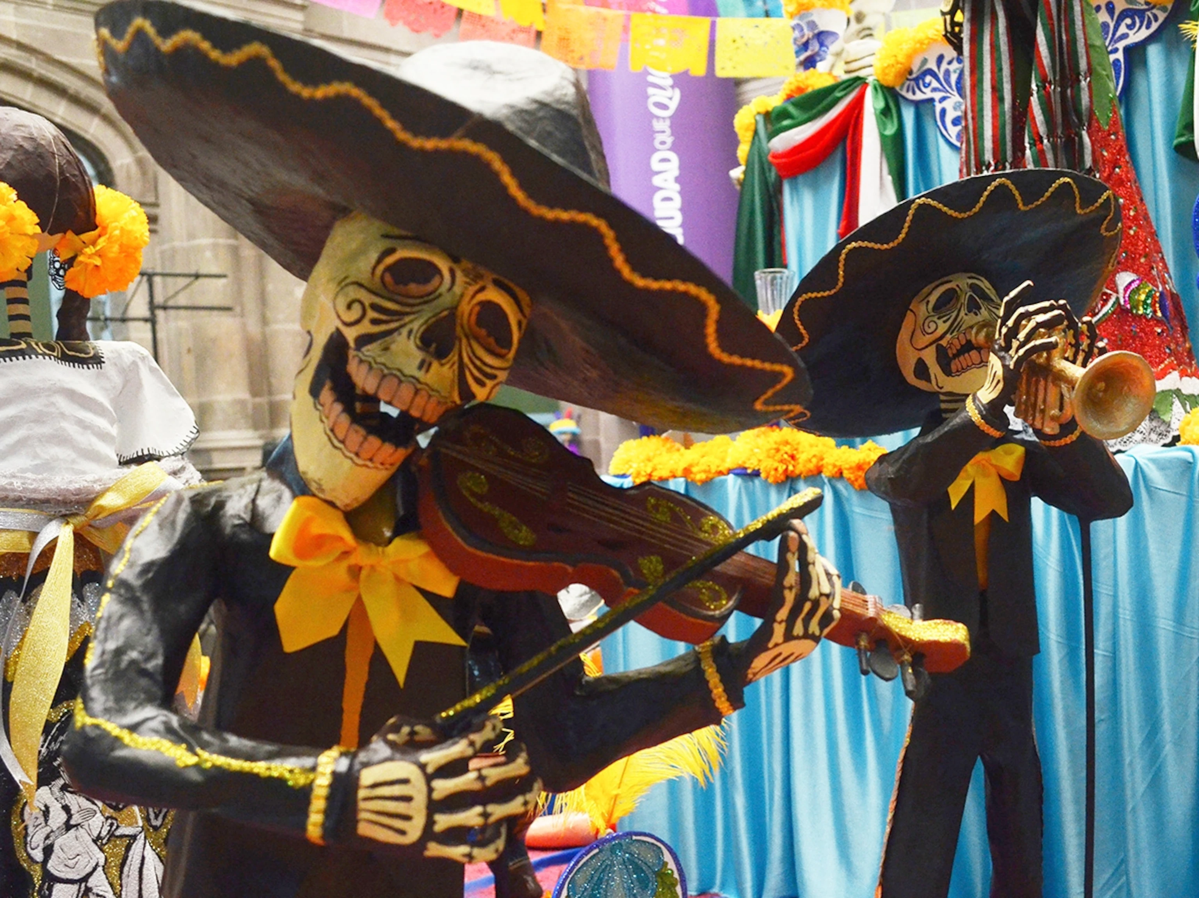
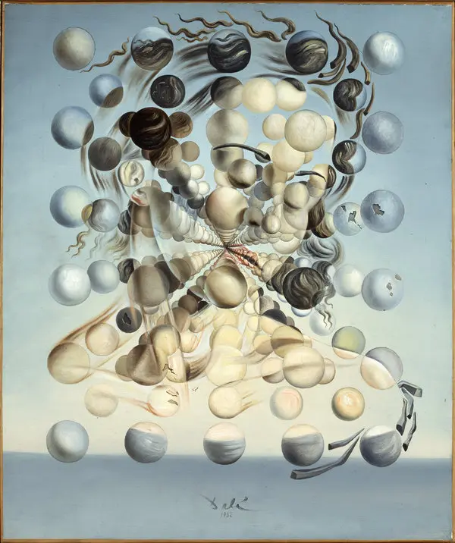
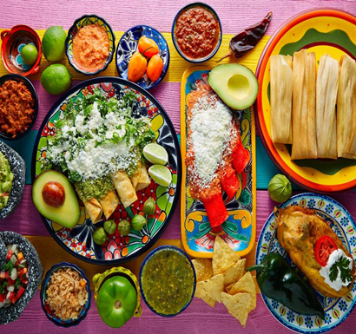
Hispanic Heritage Festival
Friday, November 4 at 6:15 pm (before the lock-in) in the Cafeteria!
FREE and open to SCPA families.
Sign up in 233 to bring a dish or utensils. Hours awarded for donations and time; bring receipts to Ms. D in 233.
There will be a DJ, food, dominoes, and dancing!

Slide 16
Toys For Tots
Toys for Tots is a charity to help less fortunate children. To aid in this, Somerset’s National Honor Society is sponsoring it and will be holding a drive to collect toys! Toys donated must be: Unwrapped and unopened. Books can be donated but must be appropriate children/teenagers.
Location:
Front Office
Dates:
10/24/22 – 12/10/22

Slide 17
Student Parking
-Permits from 2021 – 2022 School year are no longer valid.
-Any permit number up to 0309 is NOT valid
Applications for 2022-2023 are available in the main office.
Bring completed application, $20 cash or check and your documents to Mrs. Silva – Room 205A during lunch.

Slide 18
Homecoming Dance!
Time: 6pm-10pm
Date: November 11th
Location: SCPA Campus
Theme: Out of this World
High Schoolers only (Nobody on Academic or Behavior Probation is allowed to attend). IF you buy a ticket and then get put on probation, you will not get a refund.
Permission slips are required to attend and are available in the café and at the ticket table.
Tickets sold Oct. 24 – Nov. 10 at lunch in the open spill out area.
Students: $25 (Oct. 24-28), $30 (oct. 31- Nov. 4), $35 (nov. 7-10).
Outside Guests: $30 (oct. 24-28), $40 (oct. 31- nov. 4).
No tickets sold at the door. No guest tickets sold after Nov 4.

Slide 19
Create a Greeting Card Scholarship
Scholarship is open to all high school, college, and university students. The only eligibility criteria is that students must be at least 14 years or older at the time of entry (so some middle school students may even be able to apply). Home-schooled students are also welcome apply.
There is no required “theme,” but check out the Gallery website so that your card creation falls under one of the card lines featured.
The Gallery website states that while Christmas cards are their biggest sellers, birthday and anniversary cards are also popular. Have a penchant for sympathy or “get well” messages? Those themes are also welcome. Be sure to browse the Gallery website for ideas, but also remember that their cards are targeted to a corporate clientele.
The main criteria looked at:
Overall aesthetic appeal
Quality of execution
Creativity and Originality
Successful incorporation of design elements
Appropriateness for use as a greeting card

Slide 20
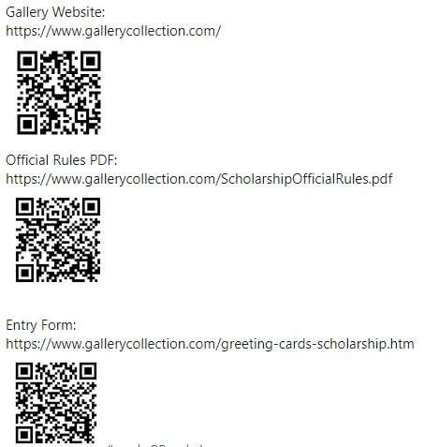
Create a Greeting Card Scholarship
The applicant with the winning entry will receive a cash scholarship of $10,000 plus a $1,000 prize for their school!
The winner’s award is paid directly to the school they will/are attending.
The Contest ends at 11:59:59 p.m. ET, March 02, 2023.

Slide 21
Come Support the following students that donated their pottery to the 30th Annual Soup Bowl fundraising event on Thursday, November 3rd, 2022
ALL Pottery Bowls will be available for view/purchase on Thursday, November 3, 2022, from 9:00 am- 7:00 pm only at the Heritage Center, in downtown Vero Beach. The donation requested for each bowl is $15.
The minimum donation continues to be $5 for a bowl of soup and $15 for a quart container of ‘soup-to-go’; however, the idea is to donate what you would have spent on that meal had you gone out to eat instead.’
Addyson Langen Alex Jaffe Amare Payne Ariana Albuquerque Atticus Agnew Ayden Salinas Ayden WIlson Brianna Armas Brianna Xavier | Brooke Peters Brooke Slater Christine Ortiz Christopher Nichols Corby Henderson David Horne David Onuoha Dlorah Lopez | Jahsai Arnoux Jaimoni Parker Jordan Folk Lexi Pyle Torres Leyla Abrahams Mackenzie Roberts Madison Gordan Marissa Indrigo | Marlee Apple Martha Jones Natalie De Souza Olivia Rios Tori Huckstep Victoria Purificato Vivianna Colon

Slide 22
Calling all artists!
FAU’s Harbor Branch is accepting Ocean Science Art from September 5th, 2022 to March 17th 2023, but they haven’t gotten a chance to update their website yet!
Please come see Mrs. Perez in 235 or email her at perez.lindsey@somersetcollegeprep.org
🏆K- 8th Grade Winner: “Harnessing the Power of Marine Sponges” by Trisha G., 7th grade
🏆High School Winner: “Coral” by Alex T., 12th grade
🏆 Adult Winner: “In Awe” by Linda S.
🏆People’s Choice Award Winner: “Tubed System” by Pjark S., 11th grade
More updates to come!!!

Slide 24
TURF DURING LUNCH
Volleyball
Monday-Friday: NO SPIKING!!!
Basketball
Monday/Wednesday: Middle school only
Tuesday/Thursday: Highschool only
Rotate Fridays

Slide 25
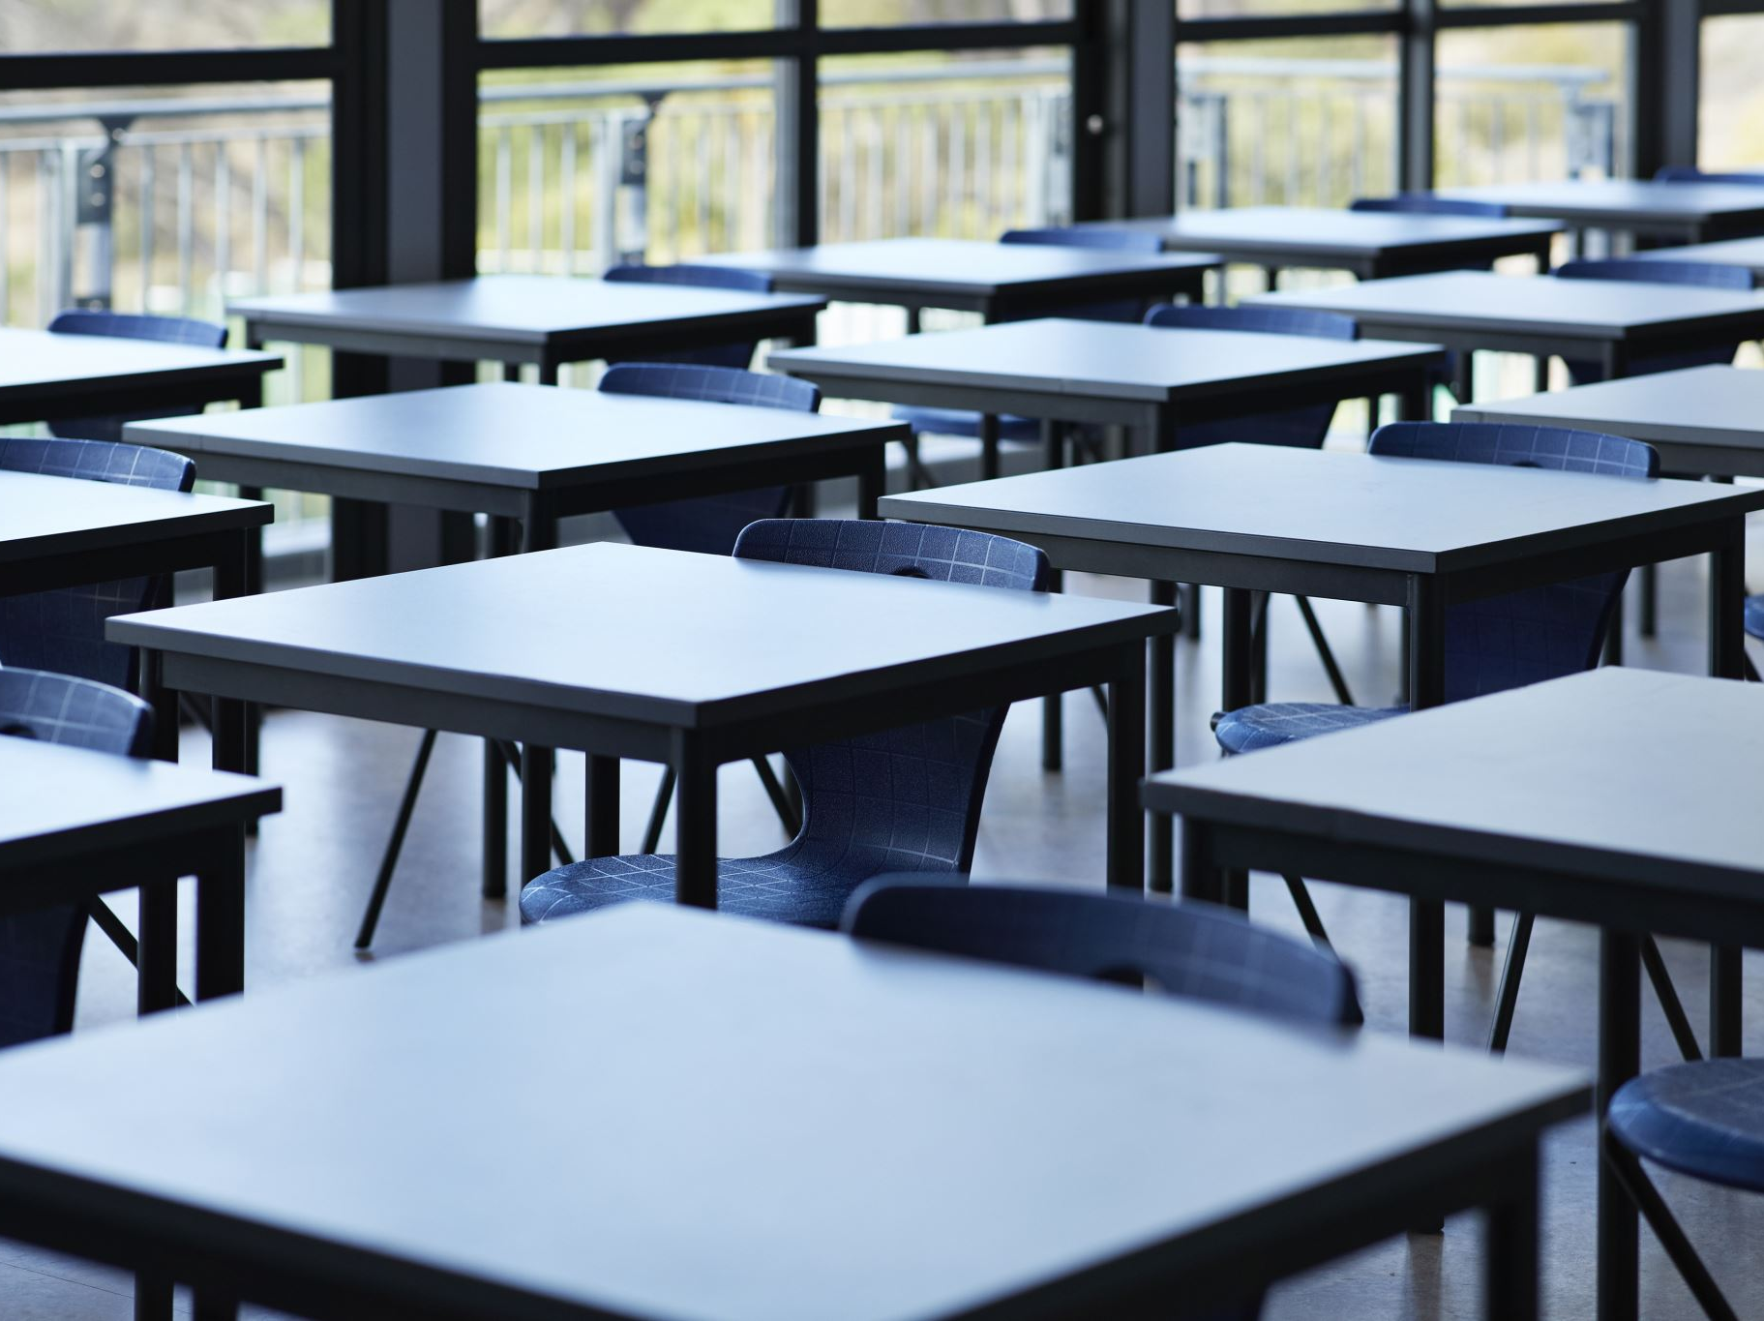
Clubs
Chorus Club for high school on Mondays, after school, in 268
D & D, Mondays, after school, in 175
Salsa Dancing in 136, on Tuesdays and Thursdays at lunch.
SGA, every other Wednesday, after school, from 3:45-5 in room 222
GSA on Wednesdays in 169 at lunch 11:55am-12:30pm
ASL on Wednesdays in the theater room, at 12pm on lunch.
Chorus Club for middle school on Thursdays, after school, in 268
Senior Committee Meeting, Thursdays, after school, in 136
Chess Club on Thursdays, during lunch, in 132

Slide 26
House Reminds
For anyone who needs the house remind this year ☺ This is important for communication with your house head.
Ares-@houseare
Athena-@scpaathena
Hestia- @househes
Poseidon- @psdnscpa
Zeus-@housezeus

Slide 27
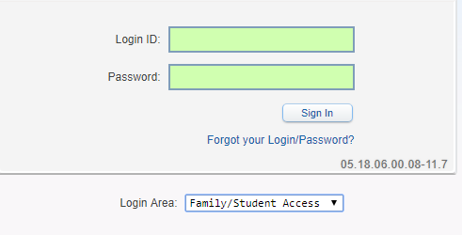
Student Skyward Access
Login ID: (Student 562#)
Password: (8 Digit Birthdate - MMDDYYYY)
Example: 08032005
**You May access Skyward through the school’s website.

